Slide 1

Bonrix Mobile Recharge System
A Comprehensive Solution for Mobile Recharge, DTH, Wallet & Payment Services
Bonrix Software Systems
Ahmedabad, Gujarat, India

Slide 2
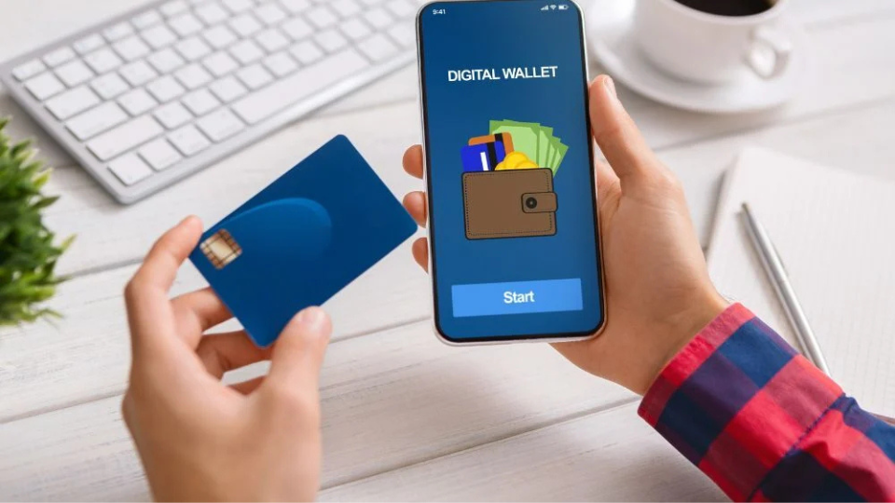



Company Overview
Bonrix Software Systems
Location
Ahmedabad, Gujarat, India
Business Focus
Mobile recharge solutions for administrators, distributors, dealers, and users
Mission
Providing seamless and secure recharge solutions for mobile, DTH, and payment services
Experience
Technology
Leading provider since 2005
Web & desktop applications
Services
Support
Multi-platform recharge solutions
24/7 technical assistance

Slide 3
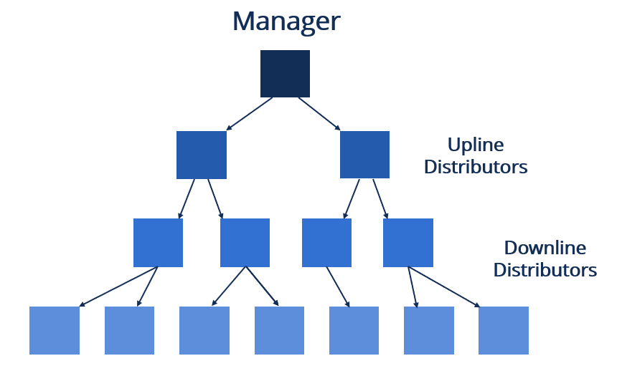














System Architecture
Multi-Tiered User Structure
Admin
System administrator with full control
Master Distributor
Top-level distribution partner
Distributor
Regional distribution partner
Key Architecture Features
Secure access control
Real-time processing
Dealer
Local retail partner
High performance
Multi-platform support
User
End customer
Scalable infrastructure
Data redundancy
Staff
Support personnel
Hardware Components
8 port 2G MODEM
8 port 3G MODEM
32 port 3G MODEM
16 port 2G MODEM
16 port 3G MODEM
32 port 2G MODEM

Slide 4

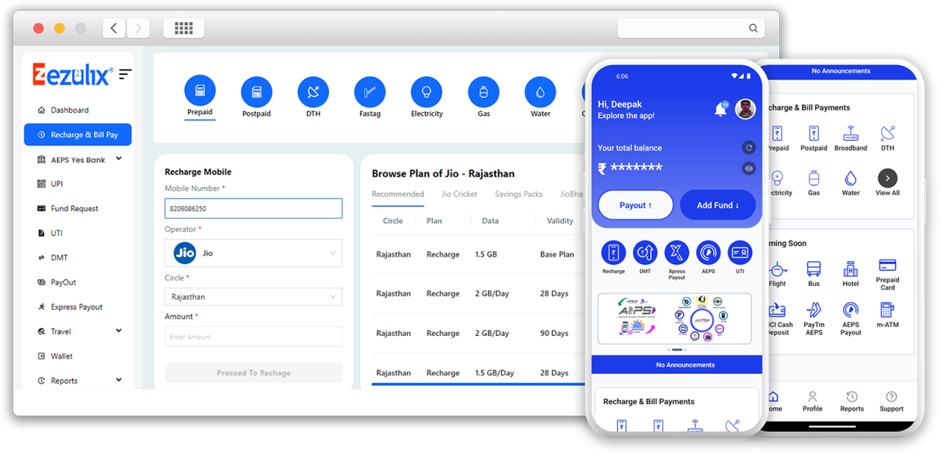








Software Solutions
Core Software Components
Mobile Recharge API
Retailer System
Integration system for third-party applications and services
Complete solution for retail recharge operations
Advance SMS Express
SerialPort Utility
Bulk SMS management and automated notifications
Hardware communication and modem management
Software Advantages
Secure transactions
Fast processing
Gtalk AutoReply
Gtalk Retailer
Real-time updates
Multi-platform
Easy integration
Automated response system for customer queries
Chat-based retailer management interface
24/7 support

Slide 5










Recharge Options
Available Services
DTH Recharge
Wallet Recharge
Direct-to-Home television recharge services for all major operators
Digital wallet top-up and balance management
Mobile Apps
Money Transfer
Dedicated applications for on-the-go recharge services
Secure money transfer services between accounts
Service Benefits
AePS
B2C Recharge Report
Secure transactions
Instant processing
Aadhaar Enabled Payment System for secure transactions
Multi-platform
24/7 availability
Real-time alerts
Comprehensive reporting for business-to-consumer transactions
Transaction history

Slide 6

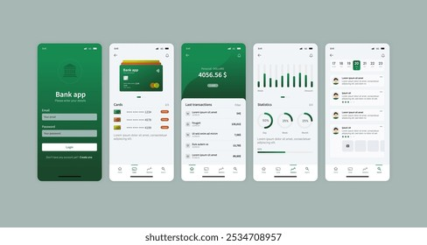










Application Types
Available Platforms
Android Apps
GPRS
Native mobile applications for Android devices
General Packet Radio Service for mobile data
JsonWeb
Admin Panel
Web-based interface with JSON data exchange
Centralized management interface for administrators
Additional Applications
Retailer Panel
USSD
Gtalk
Web App
Desktop App
Retailer App
Dedicated interface for retail partners
Unstructured Supplementary Service Data for quick access
Multi-platform
Real-time sync

Slide 7

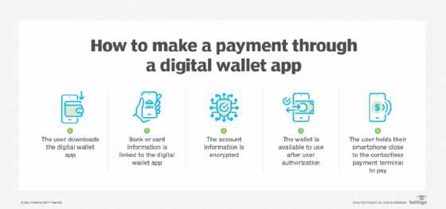






System Features and Benefits
Performance Metrics
98%
3-5
Success Ratio
Seconds per Recharge
Key Features
Customer Benefits
Multi-Platform Support
Secure Transactions
"The system has reduced our transaction processing time by 70% while maintaining excellent success rates."
End-to-end encryption for all financial operations
Works across web, desktop, and mobile platforms
— Distributor, Mumbai
Real-Time Processing
"Multi-platform support allows our retailers to serve customers anytime, anywhere with minimal training."
24/7 Support
Instant confirmation and status updates
Round-the-clock technical assistance
— Master Distributor, Gujarat

Slide 8

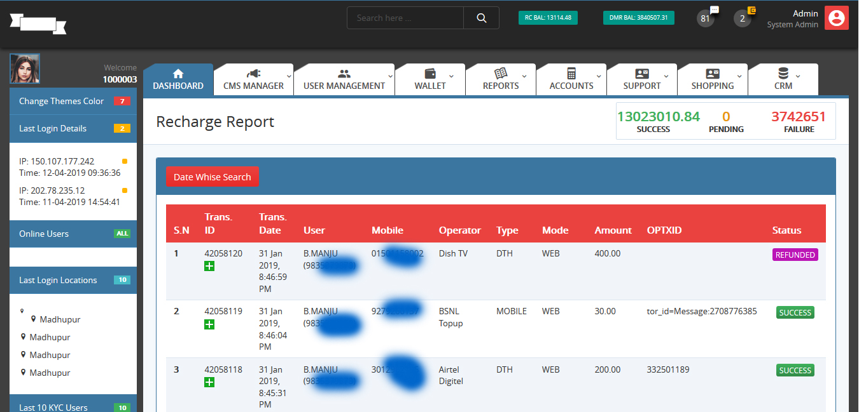





Demo and Access
Software Downloads
Recharge API System
Complete API integration solution
Retailer System
Retail management application
Advance SMS Express
Bulk SMS management tool
Contact Information
Desktop Retailer
A-801, Samudra Complex, Near Klassic Gold Hotel, Off C.G.Road, Ahmedabad, Gujarat, India
Desktop application for retailers
info@bonrix.net
+91-9426045500, 9429045500

